Slide 1
Beowulf: A Pagan and Christian Hero
Alan Haffa

Slide 2
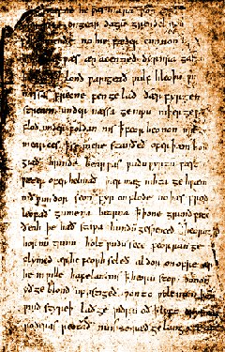
Beowulf: Textual History
Composed between mid 7th c. and end of 10th c. in Anglo-Saxon, in England
Originally an Oral Poem whose subject goes back to the 6th c.
One manuscript in British Library

Slide 3
Poetry and Meter
Old English
No stanzas or rhyming
Each line of verse composed of two balancing halves separated by a caesura
Each half line contains two stressed syllables
Alliteration ties together half-lines
No set syllable meter: 8-12 syllables

Slide 4
Oral Composition
Scop—Anglo-Saxon oral poet
Repetition
Formulas
“scourge of many tribes”
Themes or Motifs
Hospitality
Imitation and Originality
How does the oral poet add his original touch?

Slide 5
Historical Context for Story
End of Roman Empire in 476 C.E.
Angles and Saxon Invasion, 500 C.E.
Conversion of Anglo-Saxon England, 6th-7th c.
Poem is set in this early Medieval era when paganism was being challenged by Christianity

Slide 6
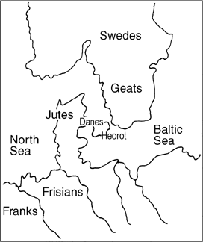
Map

Slide 7
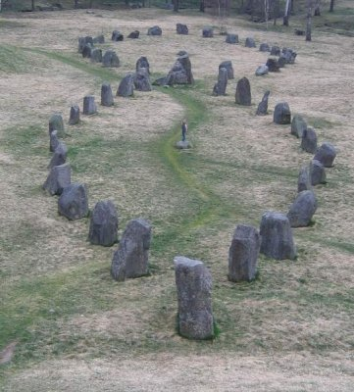
Shield Sheafson: Founder of Danes
“There was Shield Sheafson, scourge of many tribes, a wrecker of mead-benches, rampaging among foes...A foundling to start with, he would flourish later on…Each clan on the outlying coasts beyond the whale-road had to yield to him and pay tribute. That was one good king.”

Slide 8
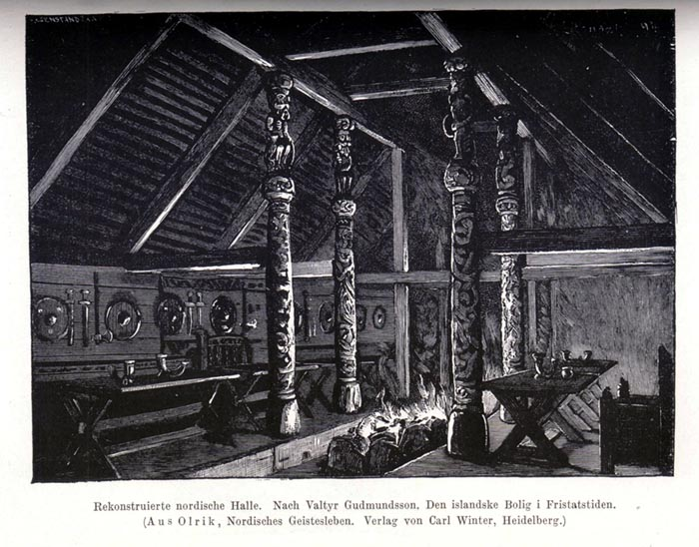
Heorat built by Hrothgar
Heorot was the name…the hall towered, its gables wide and high and awaiting a barbarous burning. That doom abided, but in time it would come: the killer instinct unleashed among in-laws, the blood-lust rampant.”

Slide 9
Grendel: Off spring of Cain
“Then a powerful demon, a prowler through the dark, nursed a hard grievance. It harrowed him to hear the din of the loud banquet every day in the hall, the harp being struck and the clear song of a skilled poet telling…how the Almighty had made the earth…”

Slide 10
Pagan Shrines and Rituals Fail
“Sometimes at pagan shrines they vowed offerings to idols, swore oaths that the killer of souls might come to their aid and save the people. That was their way, their heathenish hope; deep in their hearts they remembered hell. The Almighty Judge of good deeds and bad, the Lord God, Head of the Heavens and High King of the World, was unknown to them…”

Slide 11
Battle with Grendel as Feud
Battle described in context of feuding: Beowulf’s father had come before as a suppliant fleeing feud-blood and Hrothgar paid the Wergild
Unferth’s story told: “you killed your own kith and kin, so for all your cleverness and quick tongue, you will suffer damnation in the depths of hell.”
Implies that battle with Grendel is a Feud

Slide 12
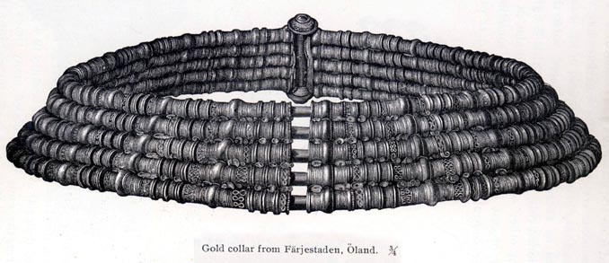
Celebration
Story of Sigemund Dragon Slayer told
Thanks given to God
Gifts given to Beowulf
Finnsburg story sung
Gift of necklace from Wealtheow

Slide 13
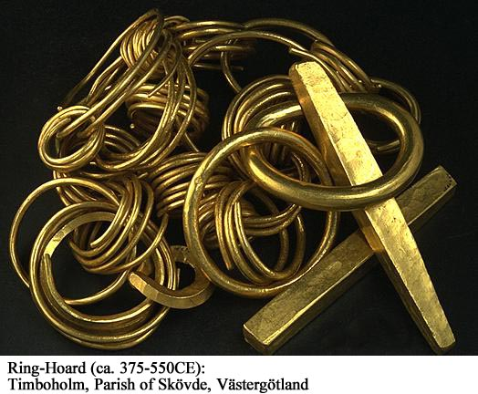
Finnsburg Story
Hildeburh, Danish princess, married Frisian King, Finn
Son and brother killed
Danes renew feud and Finn is killed, hall looted, and Hildeburh brought back to Denmark
Failed Marriage truce; foreshadows fall of Heorot and Danes

Slide 14
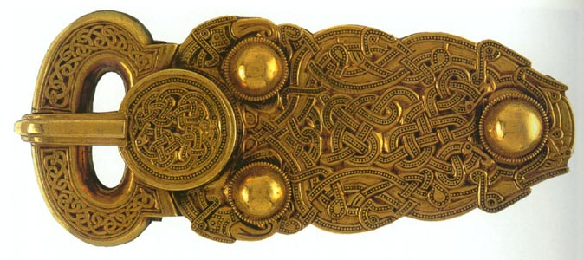
Grendel’s Mother Renews Feud
“Grendel’s mother, monstrous hell-bride, brooded on her wrongs…grief-racked and ravenous, desperate for revenge.”

Slide 15
Victory with Sword
Hrunting, sword given by Unferth, breaks
God wards off death blow
He sees a magic sword: “an ancient heirloom from the days of the giants…but only Beowulf could wield it in battle.”
Revenge and mutilation

Slide 16
Beowulf as King
Fights a Dragon
Tells his men to stay back
Wiglaf is loyal and helps him
“They had killed the enemy, courage quelled his life; the pair of kinsmen, partners in nobility, had destroyed the foe. So ever man should act, be at hand when needed;”

Slide 17
Heroic Death
Beowulf: “I took what came, cared for and stood by things in my keeping, never fomented quarrels, never swore to a lie. All this consoles me, doomed as I am and sickening for death; because of my right ways, the Ruler of mankind need never blame me when the breath leaves my body for murder of kinsmen.”
Then he asks to see treasure hoard

Slide 18
Feuding is Real Fear
Wiglaf: “Now war is looming over our nation, soon it will be known to Franks and Frisians, far and wide, that the king is gone. Hostility has been great among the Franks since Hygelac sailed forth at the head of a war fleet into Friesland…Nor do I expect peace or pact-keeping of any sort from the Swedes.”
Recalls a feud with Swedes and notes that they will take the opportunity now for revenge

Slide 19
Summary
Beowulf is the first English poem but it reflects the era and culture of the Early Middle Ages in N. Germany and Scandinavia
Poem reflects the uneasy assimilation of Christianity with Pagan culture
Christianity is limited to the basic belief in a Creator God; Wyrd is powerful belief in Fate
Feuding between men is the real source of Fear, not Monsters
Beowulf is a hero because he was:
Loyal; Brave; Cared about the People; Generous

